Slide 1
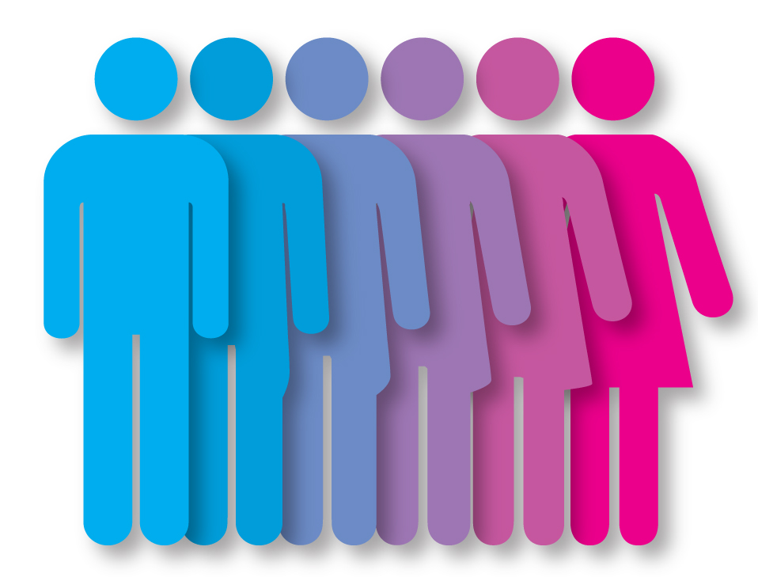
Human Variation:
Gender and Sexuality

Slide 2
Gender and Sexuality:
Biological Sex

Slide 3

Biological Sex
An identity connected to one’s reproductive anatomy, often assigned at birth based on external anatomy
(though this assignment is not always accurate)
Historically Used Legal terms (United States): Male / Female
Additional Identification:
Intersex

Slide 4
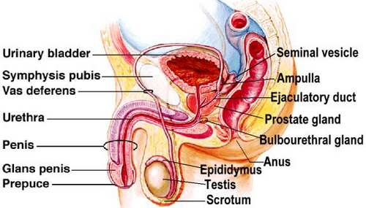
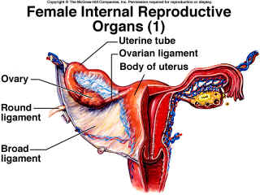
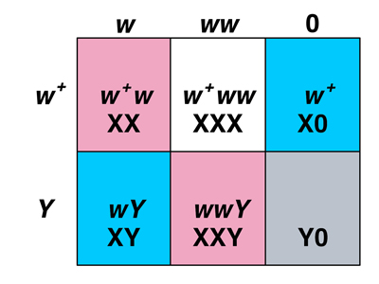
Biological Sex
Legal [U.S.]: Male / Female; external anatomy
Scientific [based on] :
1.Genetics/Chromosomes
2.internal anatomy
3. external anatomy
4. type of gonads
5. sex hormones

Slide 5
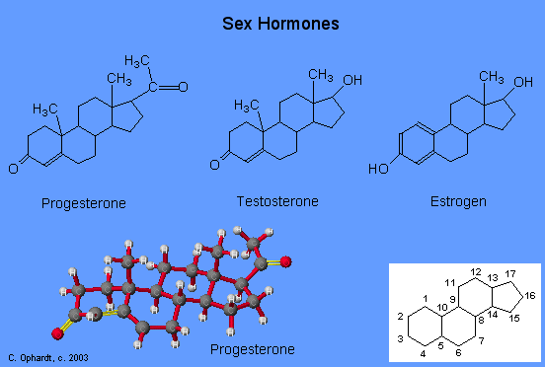
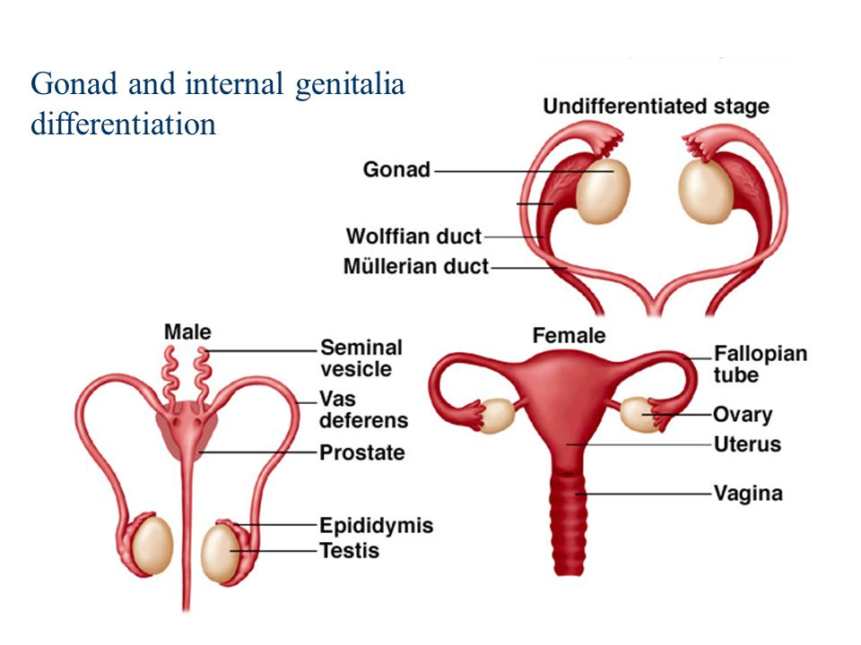
Biological Sex
Legal [U.S.]: Male / Female; external anatomy
Scientific [based on] :
1.Genetics/Chromosomes
2.internal anatomy
3. external anatomy
4. type of gonads
5. sex hormones

Slide 6
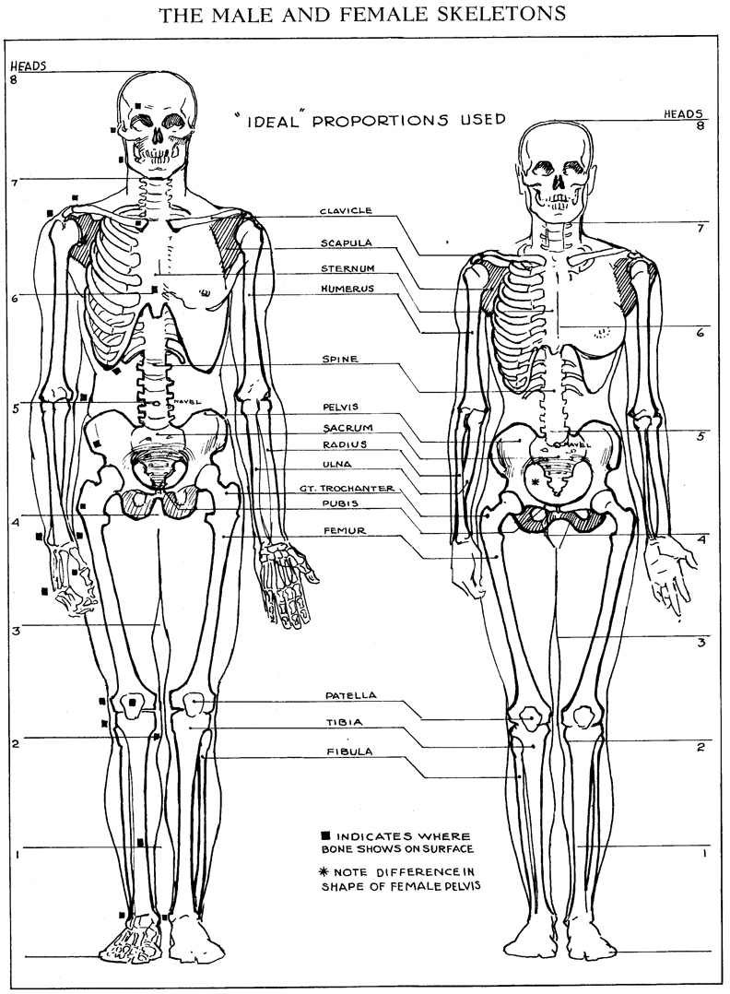
Sexual Dimorphism
Difference in characteristics of male and female biology [outside of primary characteristics -- sexual/reproductive organs:
Secondary characteristics : voice, hair distribution
Also: weight, height, strength, longevity
But– considerable overlap, too
And—Pronounced reduction

Slide 7
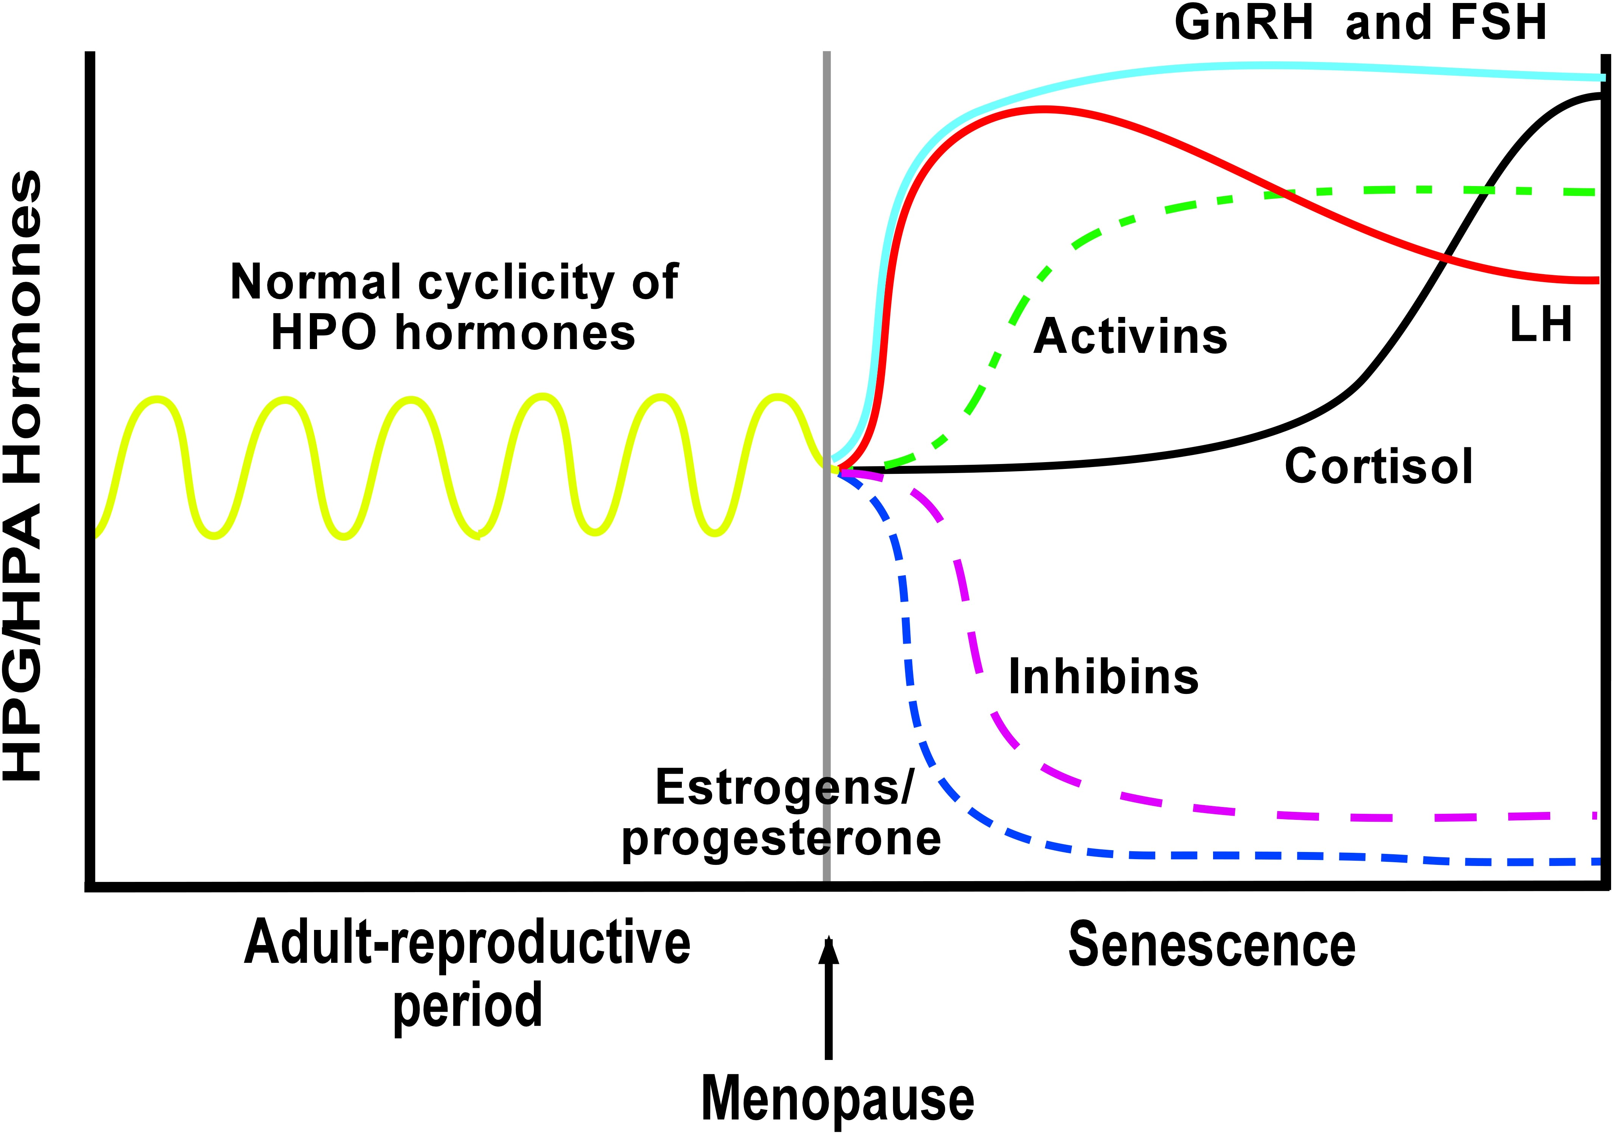
Biological Sex: Ambiguity
Biology changes over a lifetime. Cases that do not constitute the loss of ones biological sex identity:
Ejacularche – onset of capability to ejaculate
Menopause – cessation of the ability to menstruate [hormone chart >]
Hysterectomy – a removal of the uterus [and, sometimes, the ovaries too]
Testicle Removal
Cases that do constitute of a change in one’s biological sex identity
Sex reassignment therapy

Slide 8
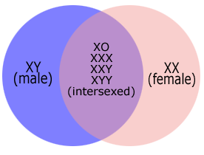
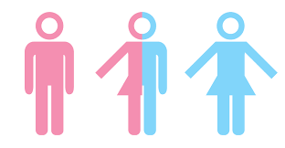
Intersex
Intersex: type of biological sex of an individual in which external and internal sexual/reproductive anatomy is mixed in a non-sexually-dysmorphic way.
Examples:
XX [female] chromosomes + internal organs, but external male anatomy
Chromosomes of a man; external anatomy of female
Chromosomes of man, external ambiguous or incompletely formed
Both ovarian and testicular tissue
Unusual chromosome combinations / sex hormone levels
Various estimates: .005-3% [1.7% often stated]

Slide 9
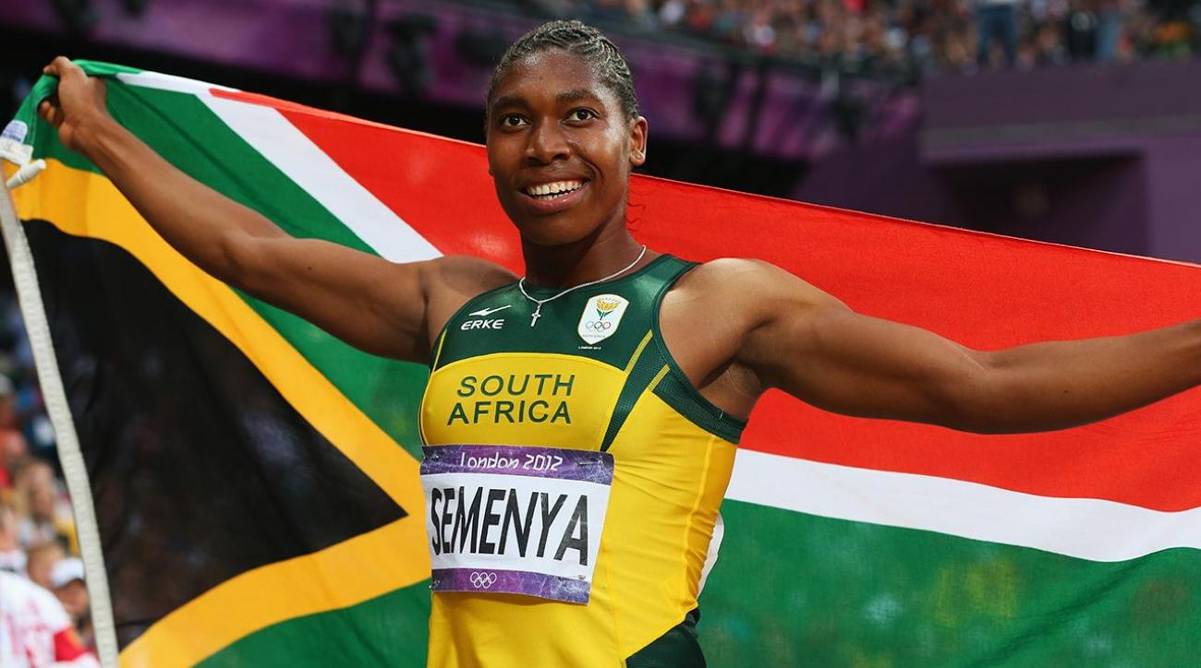
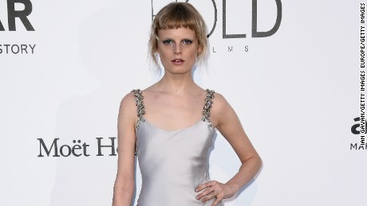
Intersex
Intersex: type of biological sex of an individual in which external and internal sexual/reproductive anatomy is mixed in a non-sexually-dysmorphic way.
Celebrities who have self-identified as intersex:
Olympic-winning athlete/long-distance runner, Caster Semenya (South Africa)
Model Hanne Gaby Odiele {France)

Slide 10
Gender and Sexuality:
Gender Identity

Slide 11
Gender
All manifestation and displays of masculinity, femininity, and androgyny.
A socially constructed system of identification that may or may not be connected with biological sex.
Demonstrations of ‘manness’, ‘womanness’, ‘transgenderness’, or ‘non-binaryness’, featuring qualities that are extraneous to biological sex characteristics.

Slide 12
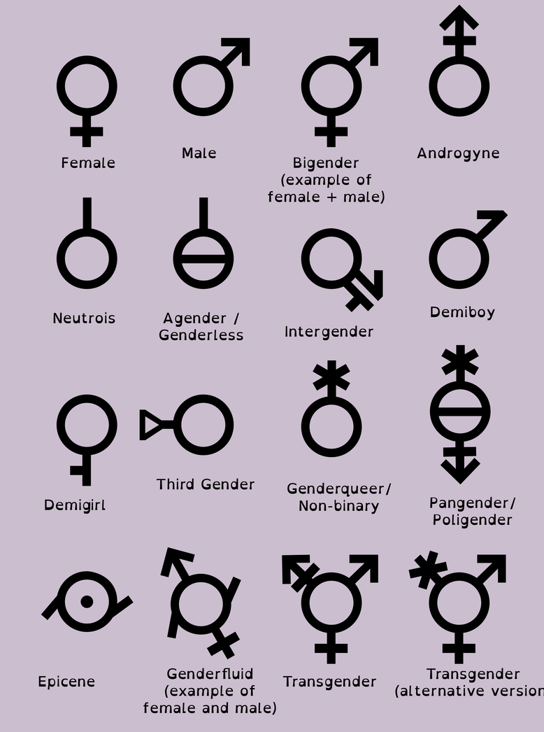
Gender Identity
Gender identity – “A person's identification by self and others as male, female, or something else.” (Kottak 2017)
Examples:
Cisgender Woman
Cisgender Man
Transgender Woman
Transgender Man
Non-Binary
Genderqueer
Genderfluid
Bigender
Agender

Slide 13
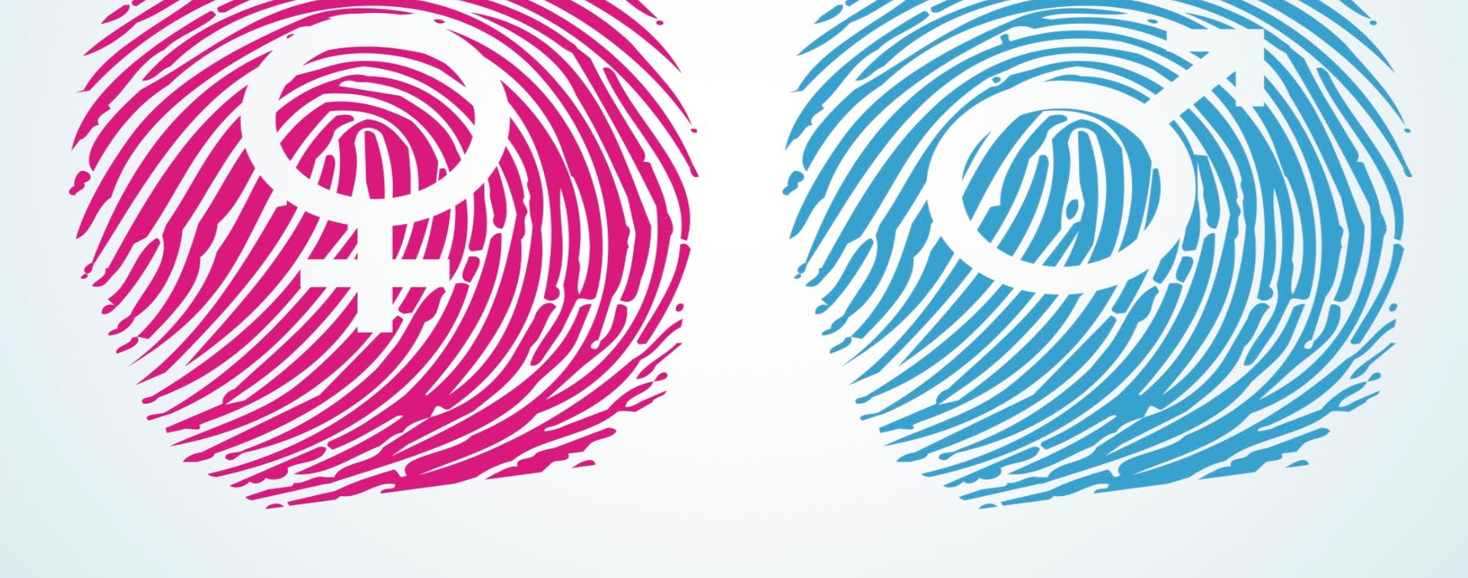
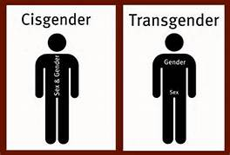
Cisgender
Cisgender identity: a gender identity category where people identify with the biological sex assigned to them at birth.
The term for when biological sex assigned at birth and gender identity matches the gender presentation a person identifies with.
Example:
  Assigned male at birth, identifies as man
  Assigned female at birth identifies as woman

Slide 14
Transgender
Transgender identity: a gender identity category where people identify with a gender that is not equated with the biological sex assigned to them at birth.
The term for when biological sex assigned at birth and gender identity does not match the gender presentation a person identifies with.
Example:
  Assigned male at birth, identifies as woman.
  Assigned female at birth identifies as man.
  Sometimes, someone might identify as both non-binary and transgender; other times, they may not overlap.

Slide 15
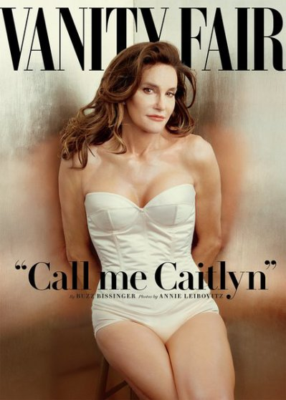
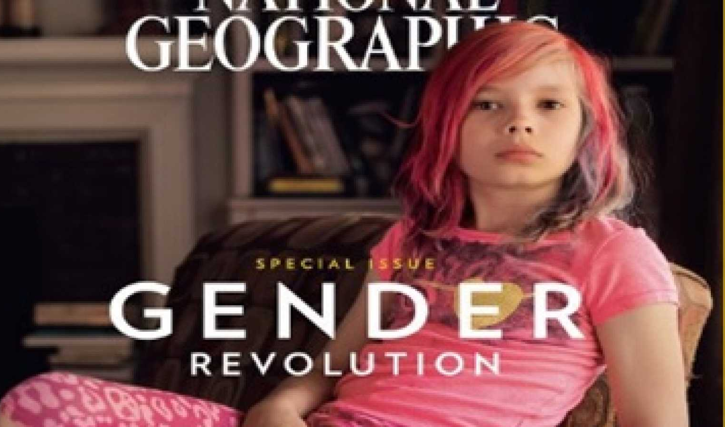
Transgender
Transgender identity: a gender identity category where people identify with a gender that is not equated with the biological sex assigned to them at birth.
The term for when biological sex assigned at birth and gender identity does not match the gender presentation a person identifies with.
Famous Examples:
Caitlyn Jenner, American television personality and retired Olympic gold medal-winning decathlete.
Avery Jackson, elementary student featured in National Geographic’s Gender issue.

Slide 16
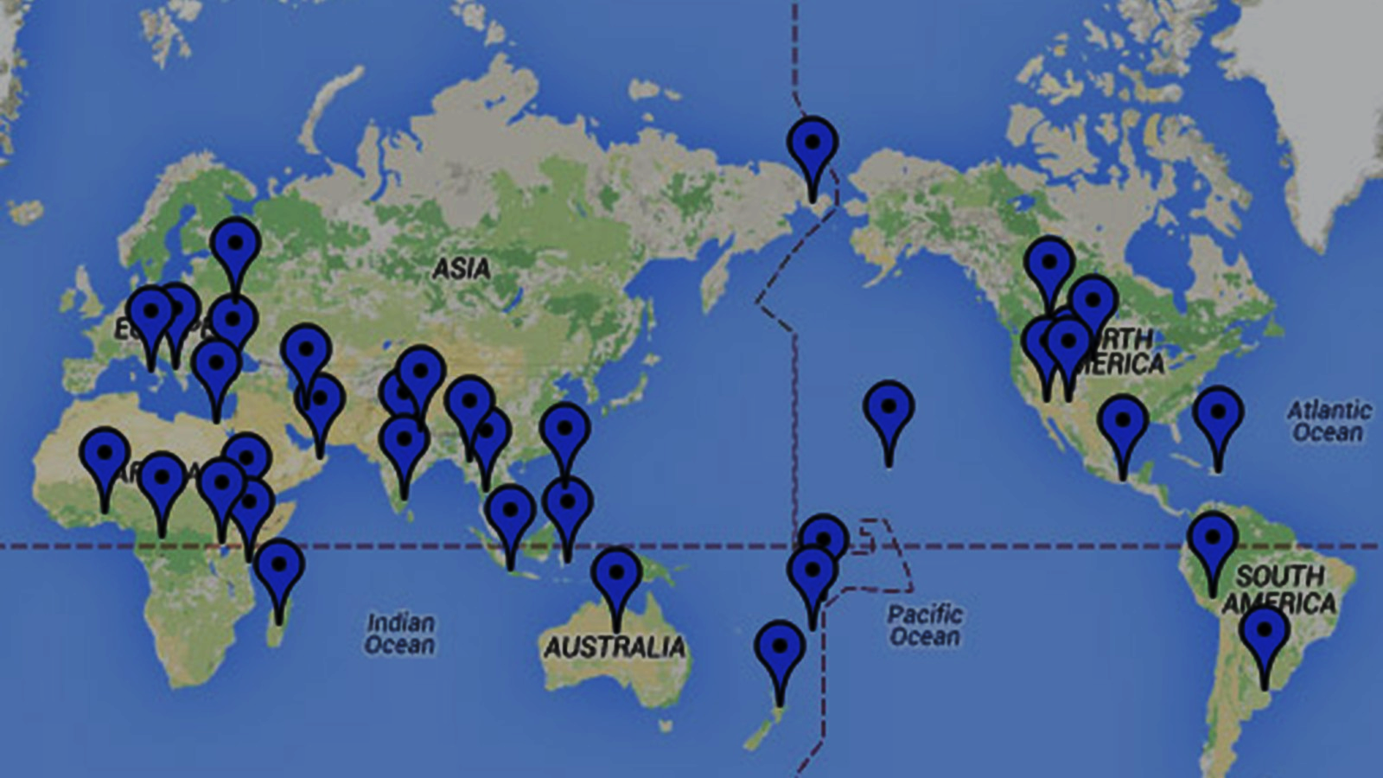
Gender and Sexuality:
Gender Diverse Communities

Slide 17
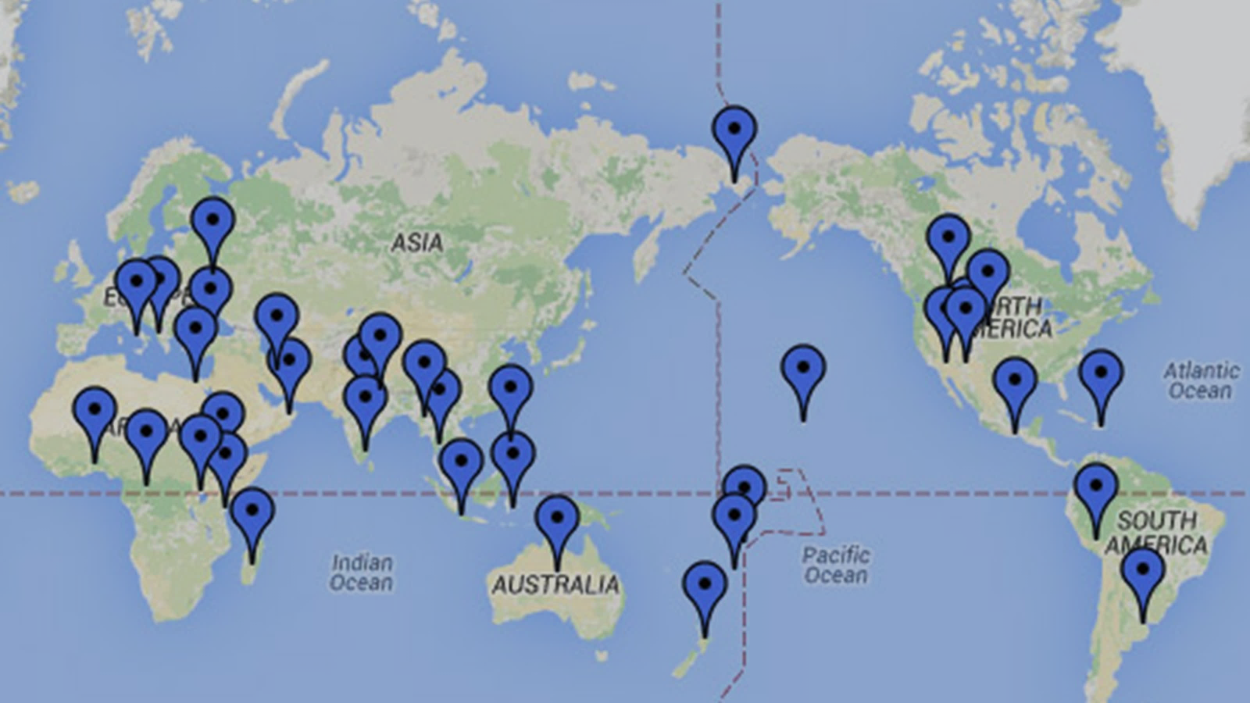
Gender Diverse Communities
Muxe or Muxhe (Zapotec of Oaxaca)
Nadleehi and Dilbaa (Navajo)
Winkte (Lakota)
Kathoey (Thailand)
Fa'afafine (Samoa)
Calabai, Calalai, and Bissu (Indonesia)
Waria (Indonesia)
Fakaleiti (Tonga)
Mahu (Hawaii)
Chuckchi (Siberia)
Ninauposkitzipxpe (Blackfoot)
Burrnesha (Albania)
Femminiello (Italy)
Ashtime (Maale, Ethiopia)
Whakawahine (Maori, New Zealand)
Quariwarmi (Inca, Peru)
Mashoga (Kenya, Tanzania)
Hijra (South Asia)
Aravani (Tamil Nadu)
Alyha and Hwame (Mojave)
Lhamana (Zuni)
Guevedoche (Dominican Republic)
Bakla (Philippines)
Xanith (Oman)
Iranian Transgender Women (Iran)
Travesti (South America)
Skoptsy (Russia)
Sekrata (Madagascar)
Acault (Myanmar)
"Sistergirls" + "brotherboys" (Aboriginal Australian)
Kwolu-aatmwol (Papua New Guinea)
Communities being reclaimed post-colonialism:
The United States
The UK
Europe
Worldwide

Slide 18
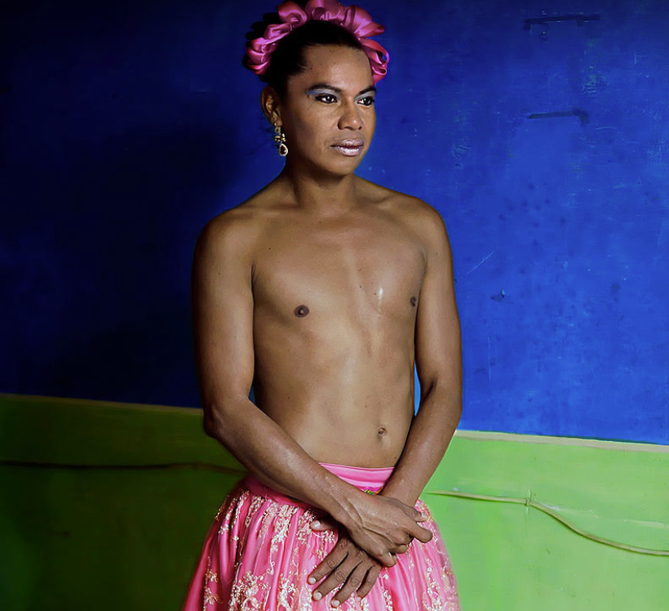
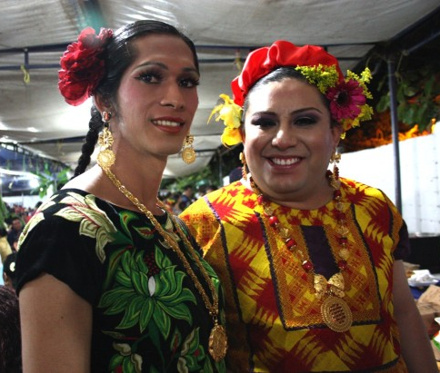
Gender-Diverse Community:
Zapotec – Oaxacan peninsula, Mexico
Muxe:
Muxe – Pronounced moo-shay
Assigned male at birth (AMAB)
Dress/behave in ways associated with ideas of femininity (women’s clothing, makeup)
May adopt feminine social roles or work in traditionally ‘masculine’ workplaces.

Slide 19
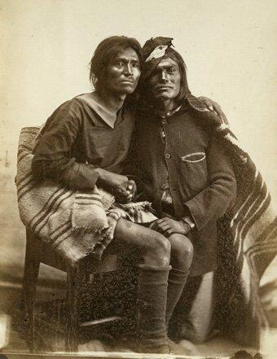
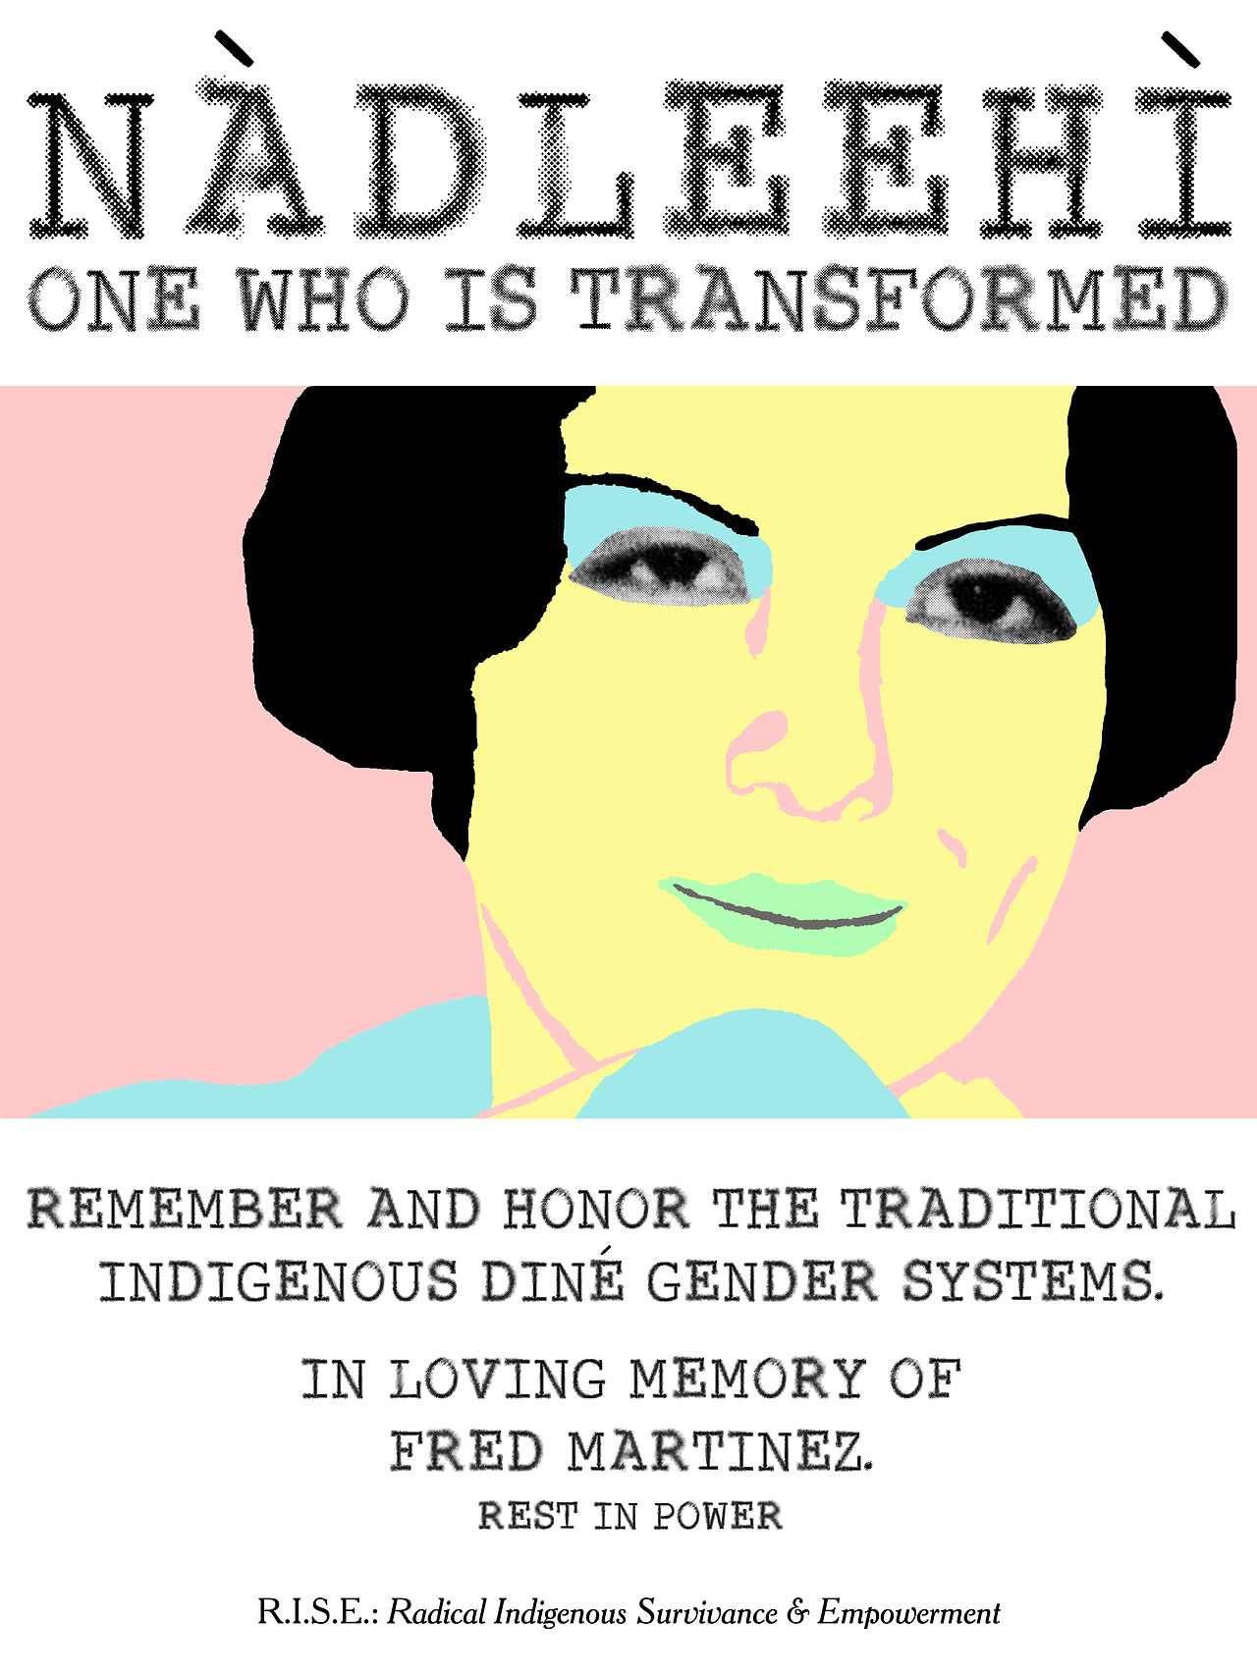
Gender-Diverse Community: Diné Navajo
Nádleehí:
Assigned male at birth
Two Spirits; embodies both masculine and feminine
Dilbaa:
Assigned female at birth
Takes on masculine social roles.
Both associated with spirituality and roles as healers.

Slide 20
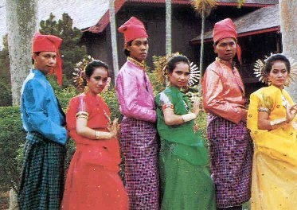
Gender-Diverse Communities:
Bugis groups
[island of Sulawesi, Indonesia]
Five Genders:
cisgender male
cisgender female
Bissu – ‘gender transcendent‘; intersex
Calabai – male sex; ‘heterosexual’ woman gendered
Calalai – female sex; ‘heterosexual’ men gendered
Other groups of Indonesia:
Waria –third gender

Slide 21
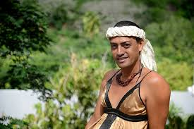
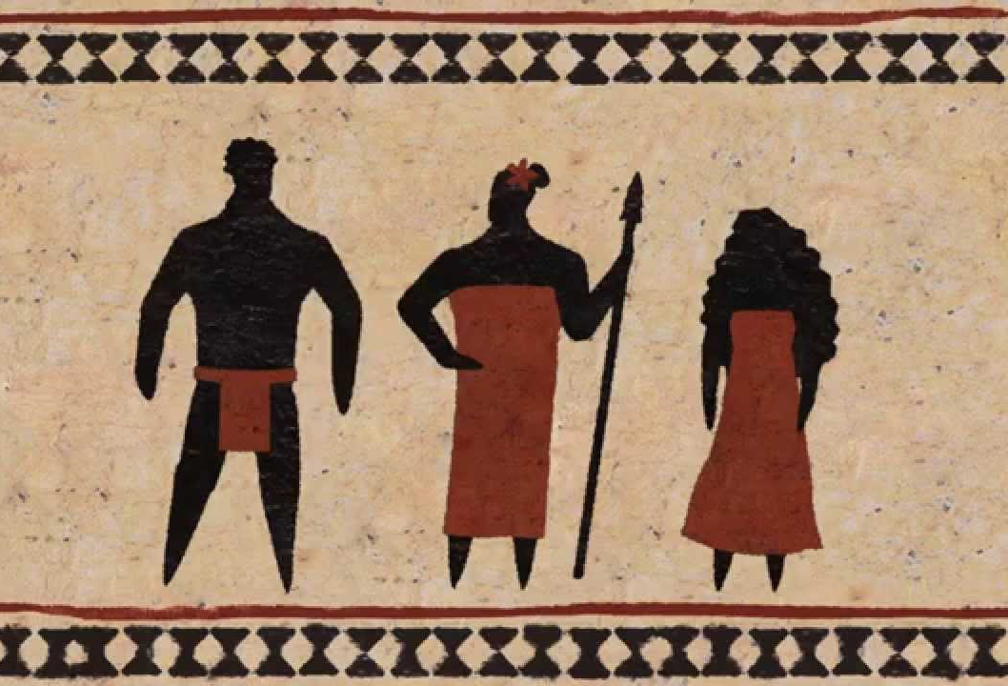

Gender-Diverse Community: Indigenous Hawaii
Māhū
Assigned male at birth
Gender role encompasses both masculine and feminine
Māhū may be any gender / may be transgender
Social role often as educators.
Ritual roles include naming children.

Slide 22
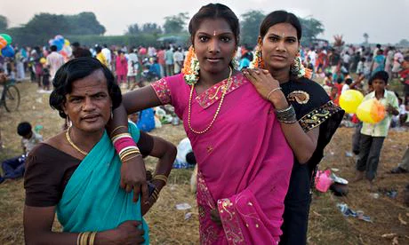
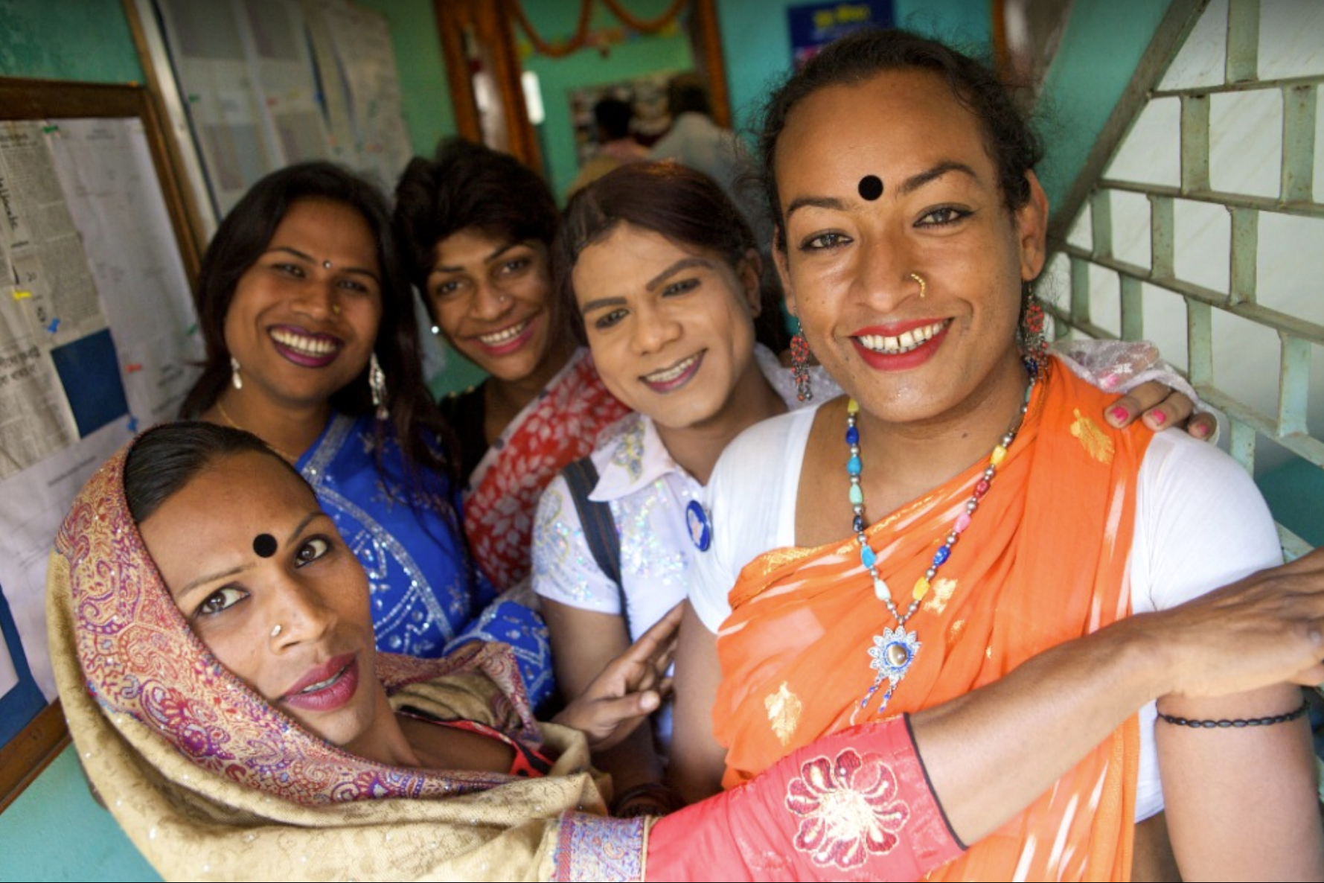
Gender-Diverse Communities: India, Pakistan, Bangladesh
Recognition of three genders (cisgender male, cisgender female, Hijra)
Hijra
Assigned male at birth
Adopt feminine gender identity / practices (women’s clothing, makeup, etc).
Previously referred to intersex or eunuch individuals
May live in Hijra communities, leadership of guru
In Hindu communities, tied to mythologies of Shiva (ageless, sexless god)
Not men, women, or transgender but ‘third gender’
Historically marginalized / subject to castration and genocide; decriminalized in 1952 but often still in poverty / sex workers.

Slide 23
Gender and Sexuality:
Gender Roles and Gender Stratification

Slide 24
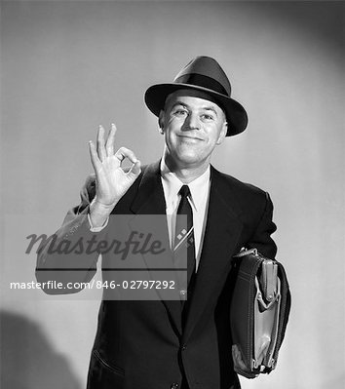
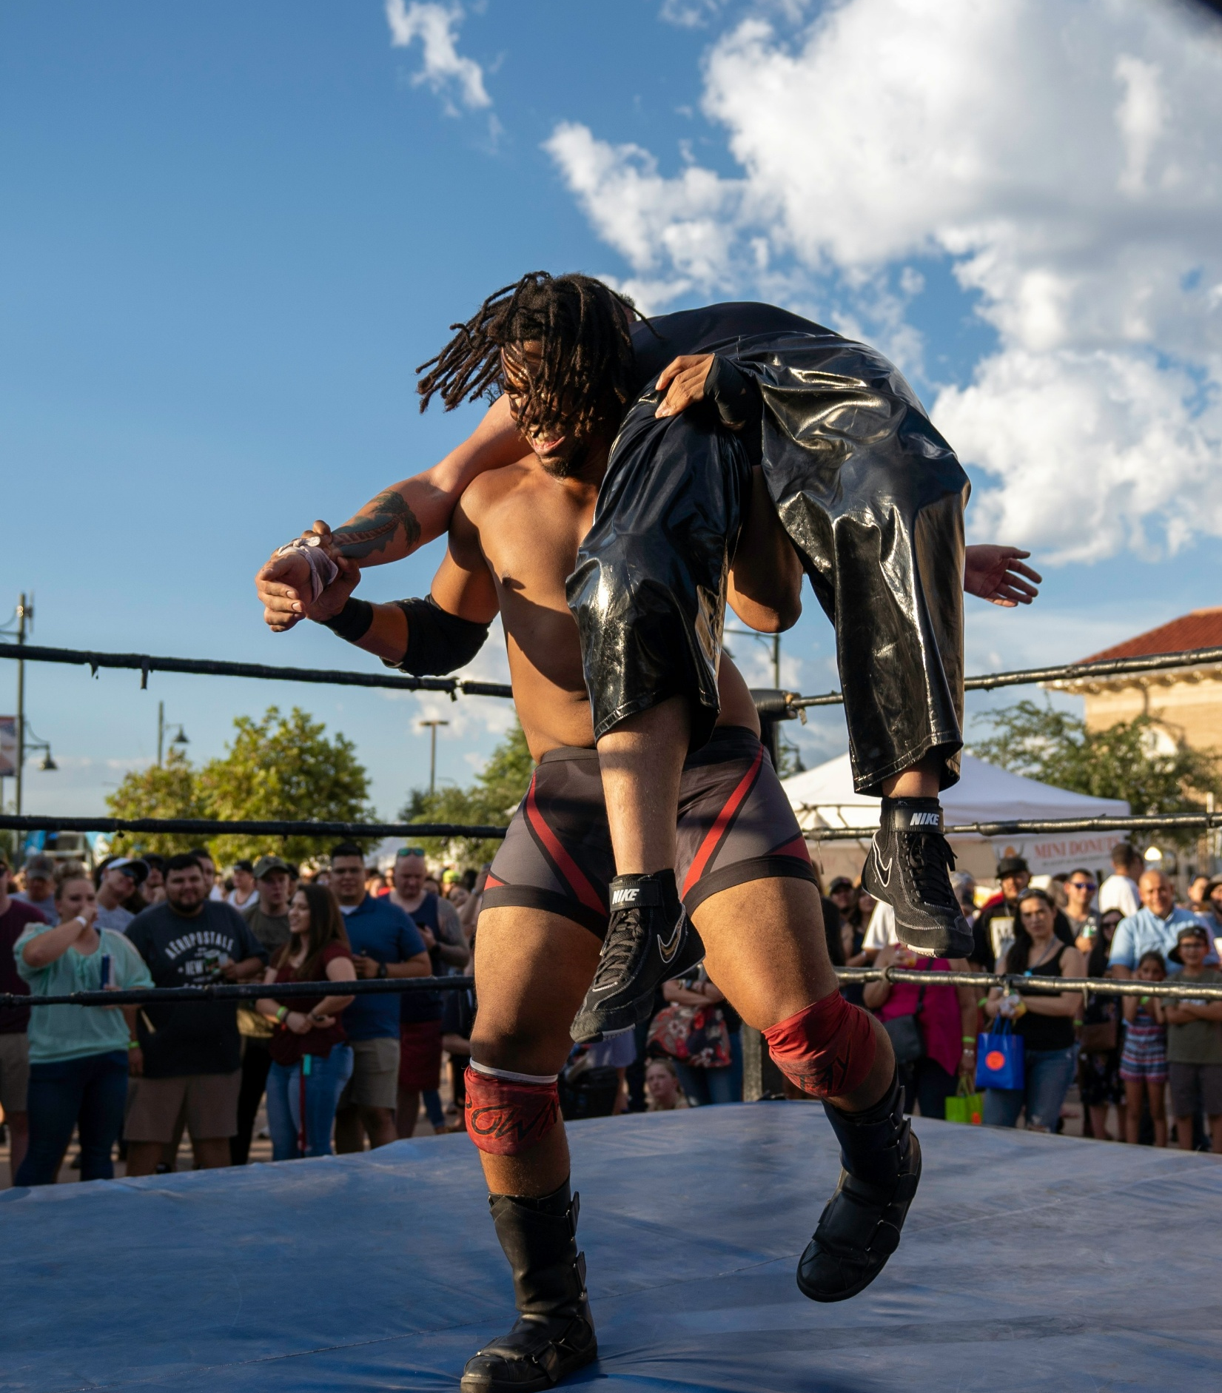
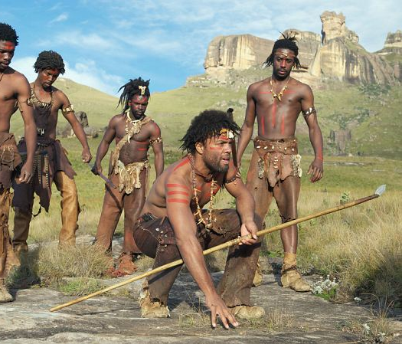
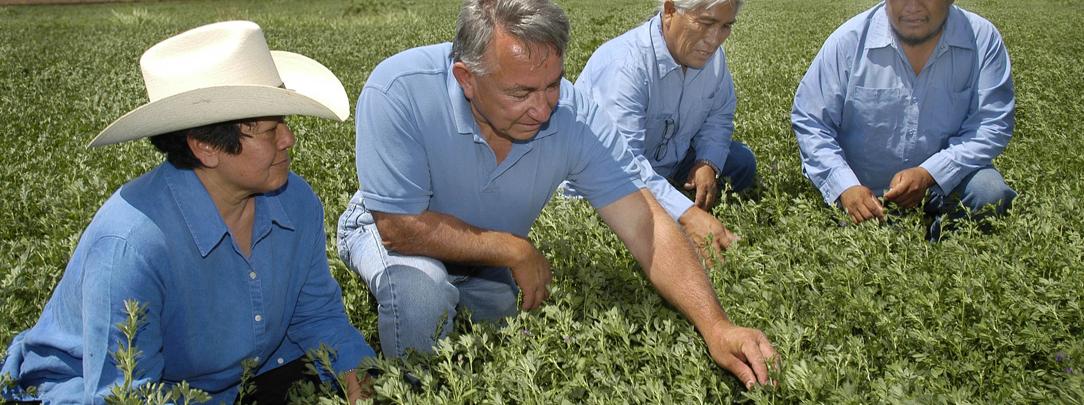
Gender Roles
Tasks/activities assigned to an individual based on gender by society

Slide 25
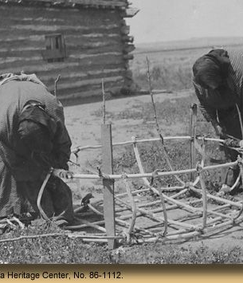
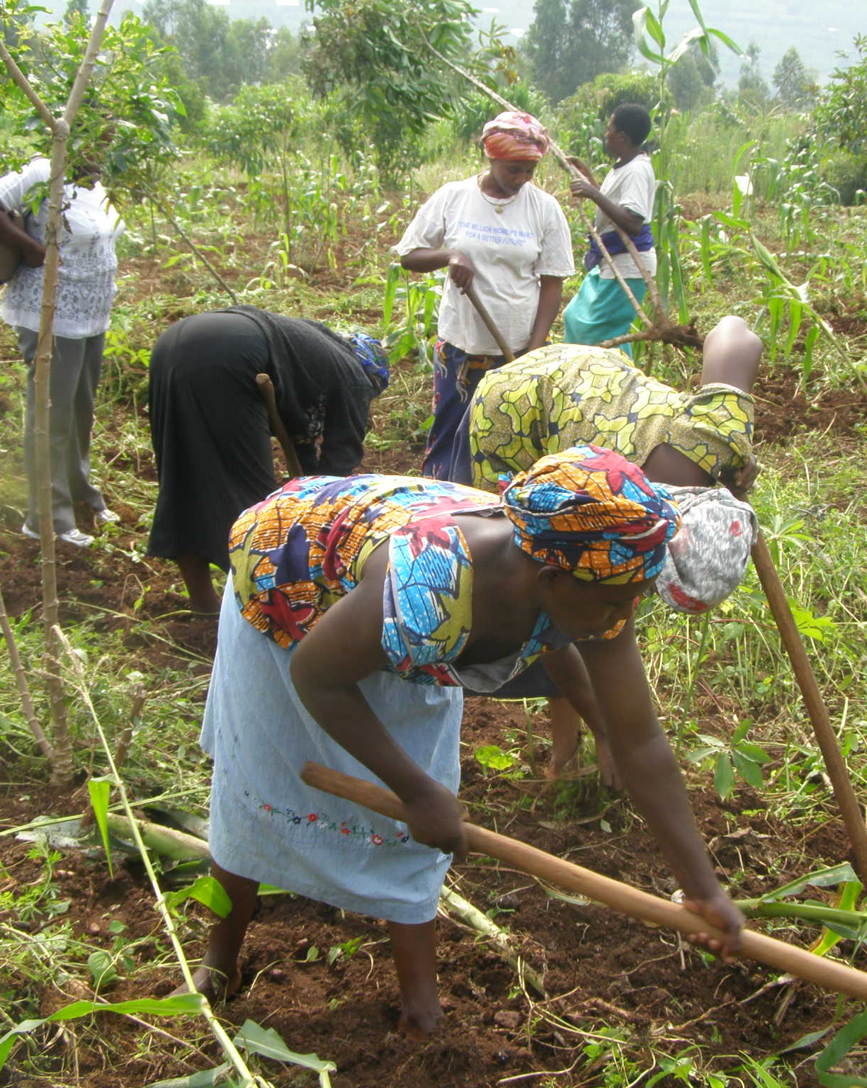
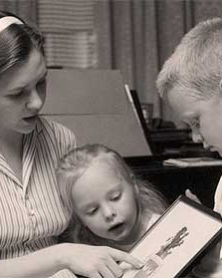
Gender Roles
FamilyID=Office_ArchiveTorn
Tasks/activities assigned to an individual based on gender by society

Slide 26
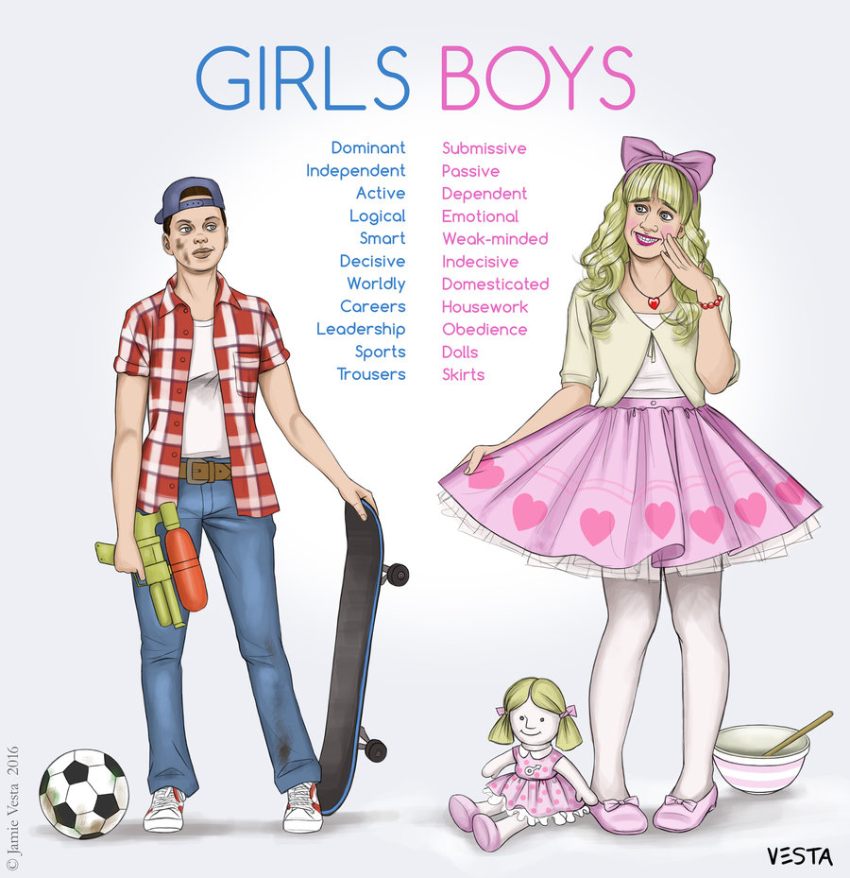
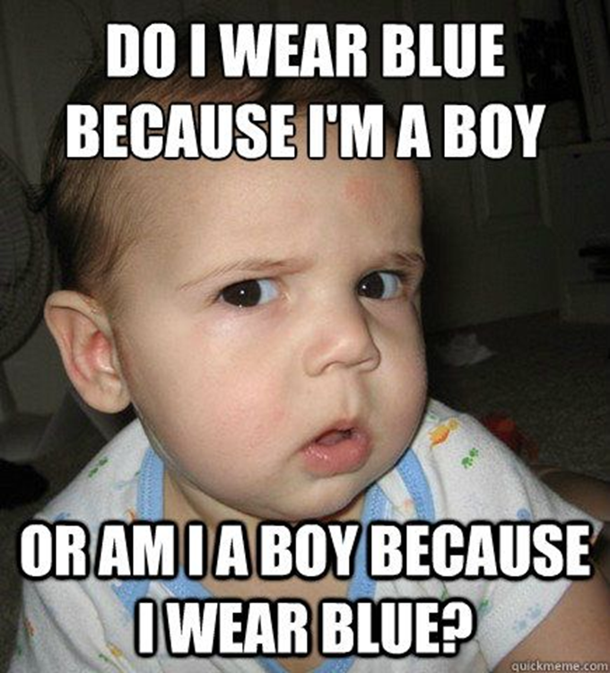
Gender Stereotypes
Set ideas about the characteristics or roles of individuals based on sex-characteristic and/or gender presentation.

Slide 27
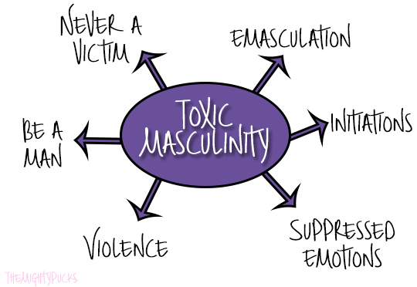
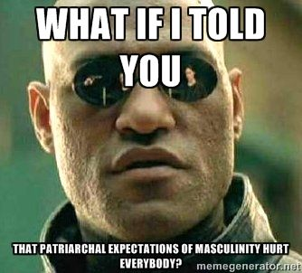
Gender Stereotypes
Set ideas about the characteristics or roles of individuals based on sex-characteristic and/or gender presentation.

Slide 28
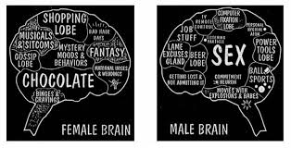
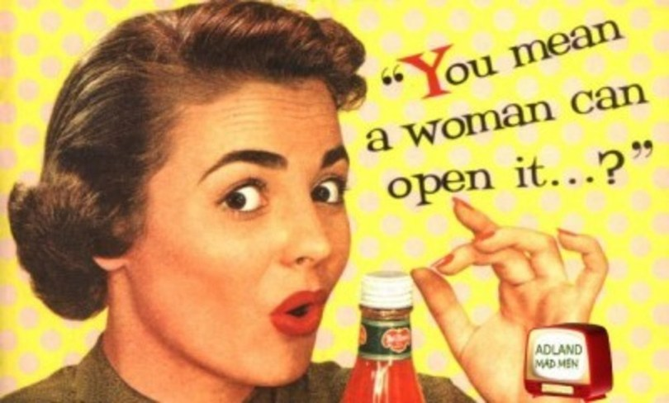
Gender Stereotypes
Set ideas about the characteristics or roles of individuals based on sex-characteristic and/or gender presentation.

Slide 29
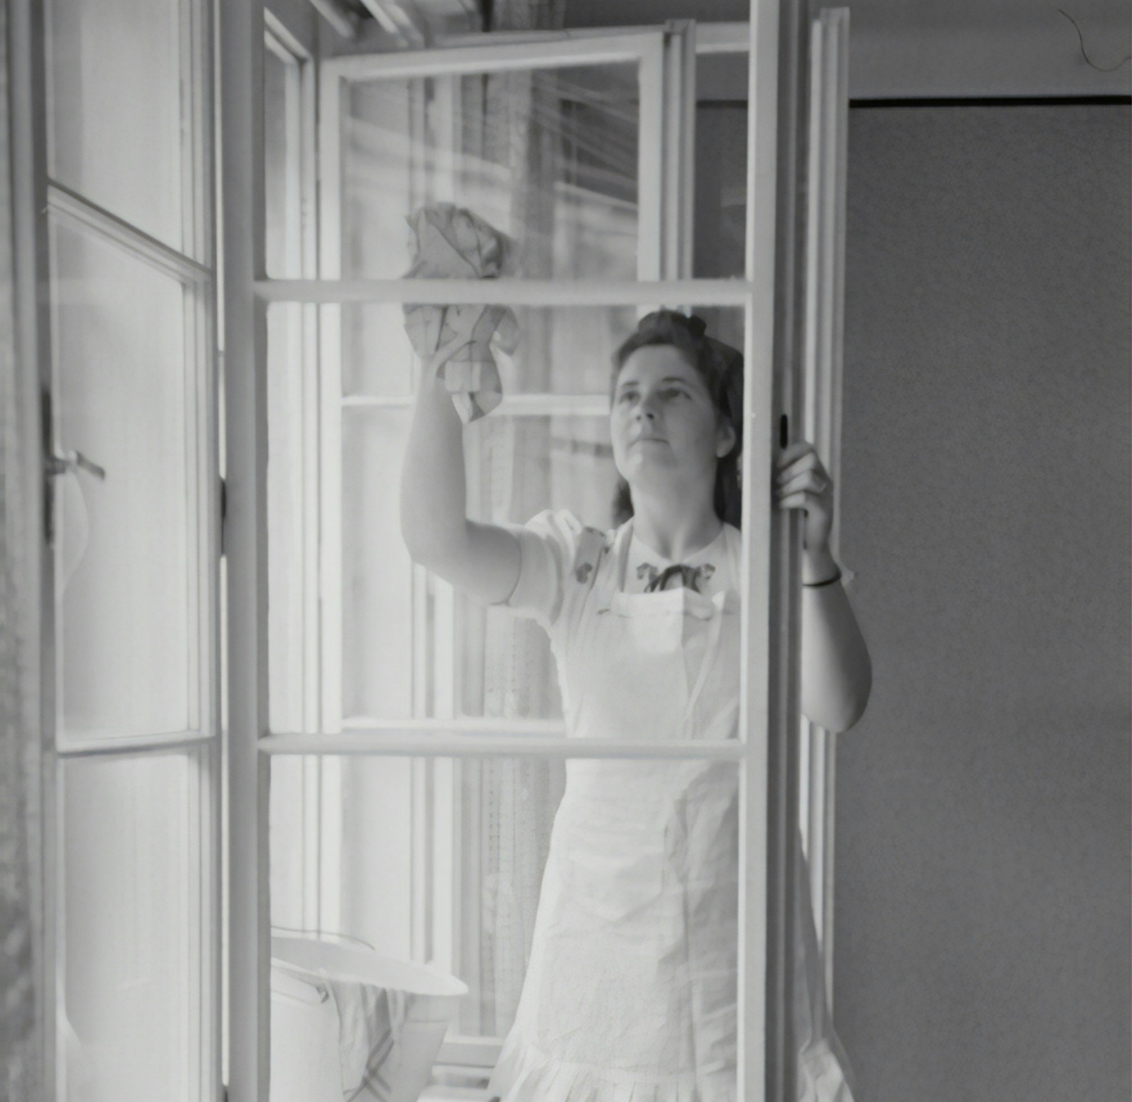

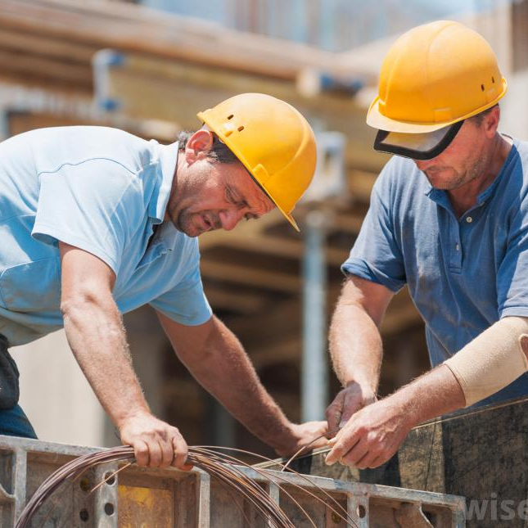
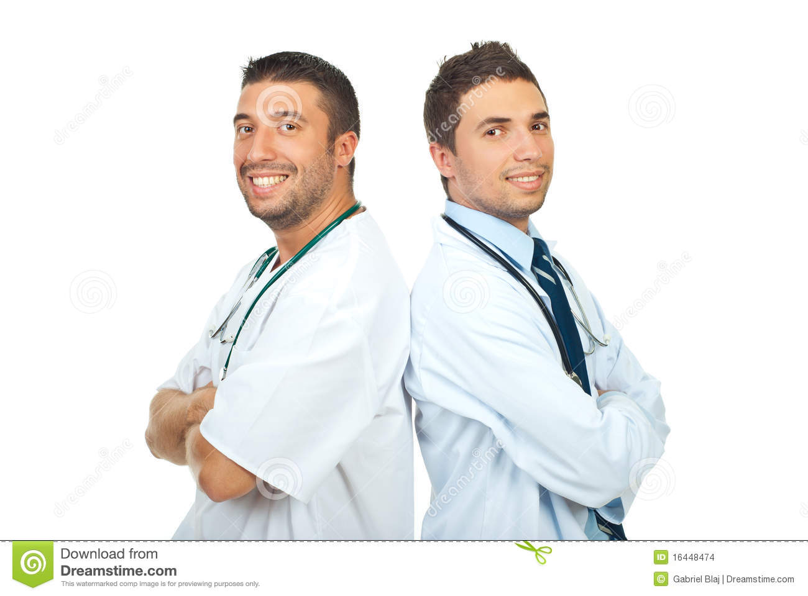
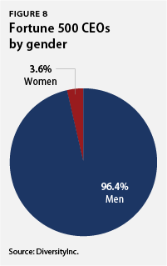
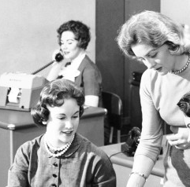
Gendered Work

Slide 30
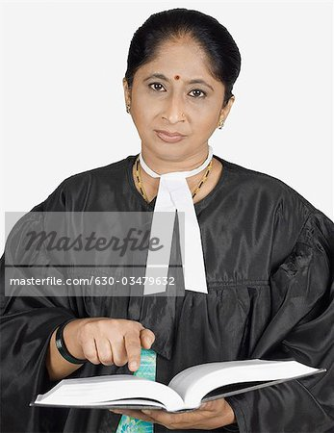
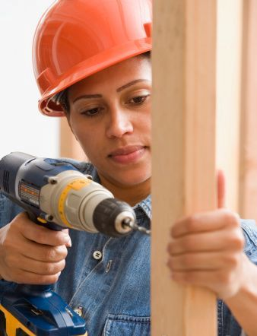

Gendered Work: Resistance

Slide 31
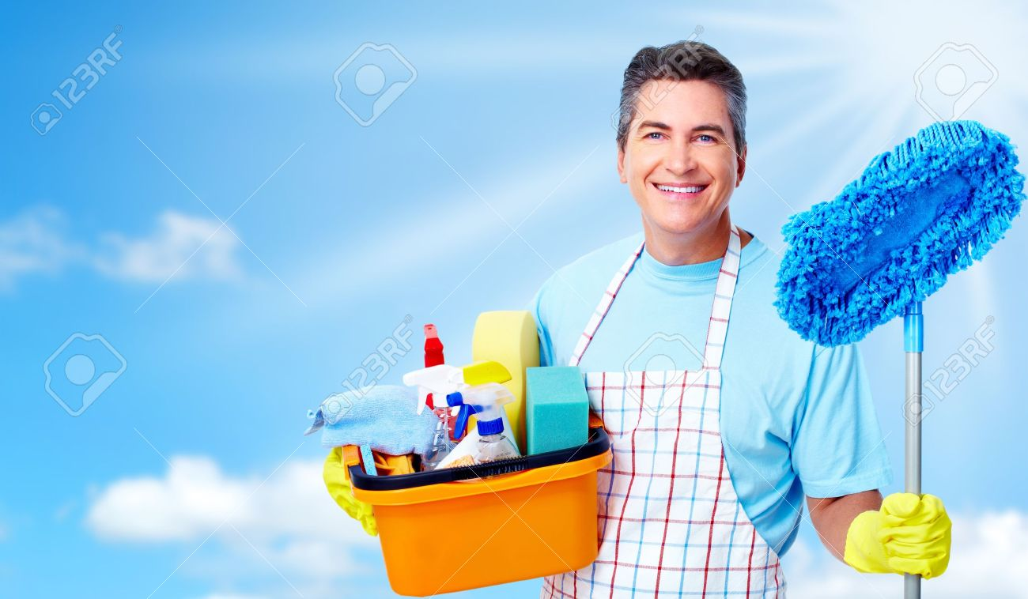
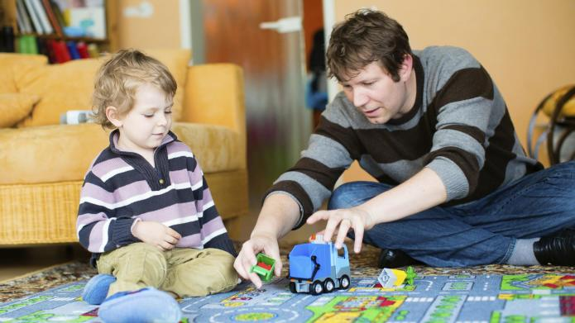
Gendered Work: Resistance

Slide 32



Gender Roles: Resistance
Ignoring gender-assignment of tasks in name of free choice.

Slide 33
Gender Roles: Resistance
Ignoring gender-assignment of tasks in name of free choice.

Slide 34

Gender Roles: Resistance
Ignoring gender-assignment of tasks in name of free choice.

Slide 35


Gender Roles: Resistance
Ignoring gender-assignment of tasks in name of free choice.

Slide 36

Gender Stratification
System in which there is unequal access to rewards of society based on gender, such as:
political, economic and social power
human rights
personal freedoms
respect, prestige
other socially-valued resources.

Slide 37


Patriarchy and Patrilineal Descent
Patrilineal descent – “Unilineal descent rule in which people join the father's group automatically at birth and stay members throughout life.” (Kottak 2017)
Patrilineal-patrilocal complex – “An interrelated constellation of patrilineality, patrilocality, warfare, and male supremacy.” (Kottak 2017)

Slide 38

Matriarchy and Matrilineal Descent
Matrilineal descent - “Unilineal descent rule in which people join the mother's group automatically at birth and stay members throughout life.” (Kottak 2017: Page)

Slide 39

Gender Stratification
System in which there is unequal access to rewards of society based on gender, such as:
political, economic and social power
human rights
personal freedoms
respect, prestige
other socially-valued resources.

Slide 40


Slide 41


Patriarchy and Violence
Patriarchy
Social and/or political system that is ruled by men
In this system, women have inferior social, economic and/or political status.
Women also often lack a number of basic human rights un

Slide 42



Patriarchy and Violence
Affect both men and women
More frequently, statistically [outside of prison settings], affect women

Slide 43



Patriarchy and Violence
Affect both men and women
More frequently, statistically [outside of prison settings], affect women

Slide 44


Gender Patterns: Reproduction and Caregiving for Children
Domestic–public dichotomy
“Contrast between women's role in the home and men's role in public life, with a corresponding social devaluation of women's work and worth.” (Kottak 2017)
Example of gender stratification.
Often exacerbates sexism in both the workplace and domestic spheres.

Slide 45


Feminization of Poverty
Obstacles that disproportionately affect women in the workforce:
Lower pay than male colleagues
Unfair distribution of childcare and domestic tasks
Workplaces not amenable to work-life balance
Harassment and sexist microaggressions

Slide 46
Gender and Sexuality:
Sex Norms and Sexual Orientation

Slide 47


Gender Patterns: Sexual Freedom
Double standard concerning premarital and extramarital sex

Slide 48



Gender Patterns: Sexual Freedom
Double standard concerning premarital and extramarital sex

Slide 49


Gender Roles, Sexual Practices: Resistance
Move to Progressive Sexual Ethics

Slide 50
Sexual Orientation
Sexual orientation
Habitual sexual attraction to person(s) of a particular sex/gender identity label
Sexual activity or behavior with a person(s) of a particular sex/gender identity label
Examples: Straight (Heterosexual), Gay (Homosexual), Bi (Bisexual), Ace (Asexual).
Also: Homoflexible, Heteroflexible, etc.

Slide 51
Sexuality And Gender: Community
LGBTQAI2+ : Lesbian, Gay, Bisexual, Transgender, Queer, Questioning, Asexual, Intersex
SAGA : Sexual and Gender Alternative
Other Labels: Heteroflexible; Homoflexible

Slide 52

The Invention of Sexuality as Identity
Pre-1800s: Sodomy Crimes
  Any sex outside marriage
  varied in degree of ‘sinful’, according to church rhetoric
1869: Sexuality moves from behavior to identity
  New terms coined:
    Heterosexuality
    Homosexuality

Slide 53



Sexual Orientation:
Straight / Heterosexual
“Straight” / “Heterosexual”
Identity label referring to individuals who gender-identify as man and woman experiencing attraction toward each other
Includes attraction of romantic-affections and/or sexual natures.
Alternate language suggested in early days of term: “Normal-Sexual”
  Problematic due to naturalizing discourse

Slide 54


Sexual Orientation:
Gay / Homosexual
“Gay” / “Homosexual”
“Homosexual” –identity label constructed in the late 1800s around the phenomenon of individuals who identify as the same gender experiencing attraction toward each other of a romantic/affectionate and/or sexual nature.
“Lesbian”: 1904 [Sappho, Isle of Lesbos –possibly misconstrued!]
“Gay” : Connotation changed to mean homosexual in 1940s

Slide 55
Sexual Orientation:
Bi / Bisexual
“Bi” / “Bisexual”
Bisexual: Identity label constructed in the late 1800s/early 1900s referring to individuals who experience romantic-affection or sexual attraction toward both men and women. Sometimes contemporarily used interchangeably with pan / to refer to attraction regardless of gender.
A Timeline Of Usage of the word “Bisexual”:
1820s – used as a alt term for transgender , hermaphrodite ;
1890s/early 1900s – transformed to current meaning
1950s: common word in lexicon / general usage

Slide 56



Sexual Orientation:
Ace / Asexual
Asexual - identity label referring to individuals with little interest in sex, often either not frequently experiencing sexual attraction, not having the urge to act upon attraction with other individuals.
Aromantic – identity label constructed around the phenomenon of individuals who do not experience attraction of a romantic/affectionate nature toward other individuals.

Slide 57


Kinsey Scale

Slide 58

Sexuality: Identity Labels
Queer:
Broad identity label contemporarily embraced by many LGBTQ+ individuals
umbrella term for non-heterosexual and/or non-cisgender individuals
Changed to contemporary connotation in early-mid 1900s, popularized in 1970s
Originally pejorative, recently being reclaimed
For some, a term with political leanings that involves a rejection of ‘homonormativity’

Slide 59


Situational Homosexuality:
Sex Between Straight Men
Kinsey study: 37 % of cisgendered men – at least 1 same-sex sexual experience in lifetime
Additional Limitations of study:
  Limited sample size
  Unreported cases due to societal enforced / unfair shame
  Race of study participants
Contemporary study on sexuality / book recommendation:
  Not Gay: Sex Between Straight White Men

Slide 60


Situational Homosexuality:
The Down-Low
Kinsey study: 37 % of cisgendered men – at least 1 same-sex sexual experience in lifetime
Additional Limitations of study:
  Race of study participants
Community specific contemporary study on African American sexuality / book recommendation:
  Nobody Is Supposed To Know: Black Sexuality on the Down Low

Slide 61





Situational Homosexuality: Gendered Seclusion
Kinsey study: 37 % of cisgendered men – at least 1 same-sex sexual experience in lifetime
Corollary: All women schools / organizations
Limitations of study:
  Limited sample size
  Unreported cases due to societal enforced / unfair shame
  Race / Gender of Study Participants

Slide 62


